Slide 1
SQL Server 2000 Internals
Transaction Logs
Ramkumar Murugesan

Slide 2
Transaction Logs
How SQL Server handles data modifications
Introduction to Transaction Log
Structure of a Transaction Log
Transaction Logging
Data Recovery
Notes:
adfasdfsadfsda

Slide 3
How SQL Server handles data modification
SQL Server maintains a buffer cache from where data retrieval happens
All data modifications are made in the buffer cache
Modifications are written to disk when a checkpoint or commit occurs or when a buffer is full to allow the buffer to hold new pages
Flushing - Writing a modified data page from the buffer cache to disk
Write-ahead logging - Flushing ensures that modification are written to logs before the commit occurs. The actual changed data might not be in the database
When a system fails/is restarted, log pages are processed first to check the integrity of the data and then the database is accessed

Slide 4
Introduction to Transaction Log
Transaction log - Serial record of all modifications that have occurred in the database
T-Log ensures that changes made to the database…
  are redone (rolled forward) in the event of a system failure
  are undone (rolled back) in the case of a rollback command
T-Log helps recover the database to a specific point in time or to the point of failure
T-Logs can span across many files (.ldf)
But, SQL Server always treats the log as one contiguous file

Slide 5
Next Section>>>
Structure of a Transaction Log
Topics…
Virtual Log Files | States of Transaction Log

Slide 6
Structure of a Transaction Log
The transaction log for any database is managed as a set of virtual log files (VLFs)
Size of VLF = {The total size of all the log files and the growth increment used when enlarging the log}
A log always grows in units of entire VLFs
Logs can be shrunk only to a VLF boundary
A VLF can exist in one of the following three states:
  Active
  Recoverable
  Reusable

Slide 7
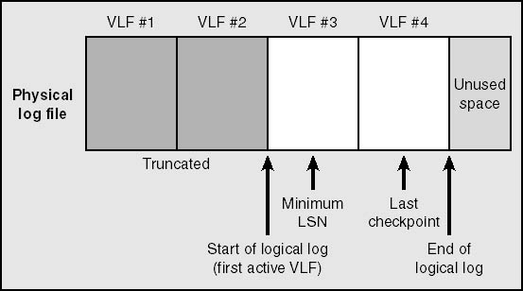
Structure of a Transaction Log
Figure: The VLFs that make up a physical log file

Slide 8
Structure of a Transaction Log
Active
  Holds all the uncommitted transactions
  The active portion of the log begins at the minimum LSN representing an active transaction and ends at the last LSN written
  Any VLFs that contain any part of the active log are considered active VLFs
  Unused space in the physical log is not part of any VLF

Slide 9
Structure of a Transaction Log
Recoverable
  The portion of the log preceding the oldest active transaction
  Used to maintain a sequence of log backups for restoring the database to a former state
Reusable
  If transaction log backups are not being maintained or if log has already been backed up, VLFs prior to the oldest active transaction are not needed and can be reused
A transaction log cannot be purged beyond the point of the earliest transaction that is still open, no matter how many checkpoints might have occurred subsequently

Slide 10
Next Section>>>
Transaction Logging
Topics…
Contents of T-Log | Log Sequence Number | Synchronous and Asynchronous Logging

Slide 11
Transaction Logging
Logging involves boundary of the beginning and end of each transaction (and savepoints, if a transaction uses them)
Between the beginning and ending boundaries, information exists about the changes made to the data for that particular transaction
Information can be…
  “Before and After" data values
  Reference to the operation that was performed for deriving its corresponding values
The end of a typical transaction is marked with a Commit record, which indicates that the transaction must be reflected in the database or redone if necessary

Slide 12
Transaction Logging
Each log entry is labeled with a log sequence number (LSN) that is guaranteed to be unique
LSN helps SQL Server to keep track of its current position in the log
Every time a data page is changed, the LSN corresponding to the log entry for that change is written into the header of the data page
Dirty pages are written to disk when the LSN on the page is less than the LSN for the last page written to the log
The buffer manager guarantees that log pages are written in a specific order
Writes to the log are synchronous
Dirty page - A page modified in the cache but not yet written to disk

Slide 13
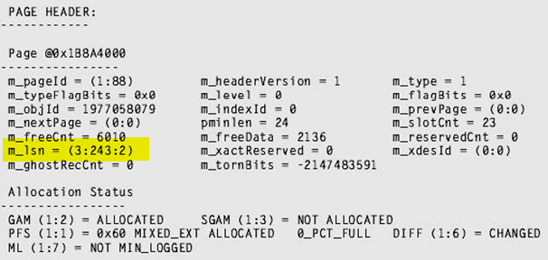
Transaction Logging
Therefore, although the writes to the log must be synchronous, writes to data pages can be asynchronous
Figure above: A Sample Page Header

Slide 14
Transaction Logging
Writes to data pages can be synchronous/asynchronous
Synchronous - SQL Server must wait for them to complete so it knows that they're safely on disk
Asynchronous - Writes to data pages need only be posted to the operating system, and SQL Server can check later to see that they were completed.
Writes to the database from log don't have to be completed immediately because SQL Server can redo the work, in the event of a power failure or system crash before the write completes
The system would be much slower if it had to wait for every I/O request to complete before proceeding.

Slide 15
Next Section>>>
Data Recovery
Topics…
Redo and Undo | Phases of Data Recovery | Behind the scenes

Slide 16
Data Recovery
A transaction aborted due to an explicit rollback or a resource error (e.g., out of memory) goes for ‘undo’ operation
The records of these changes are written to the log and marked as "compensation log records"
If the system crashes after a transaction commits but before the data is written into the data pages, the transaction must be recovered
This process is referred as ‘Redo’
Recovery refers both redo (Roll-Forward) and undo (Roll-Back) operations
Recovery process runs automatically at system startup

Slide 17
Data Recovery
In Redo, the log is examined and each change is verified as being already reflected in the database
If the change doesn't appear in the database, it is again performed from the information in the log
Undo requires the removal of partial changes made by a transaction if the transaction did not complete
During recovery, only changes that occurred or were still open (in progress) since the last checkpoint are redone or undone
Recovery involves three phases
All work based on the last checkpoint record in the transaction log

Slide 18
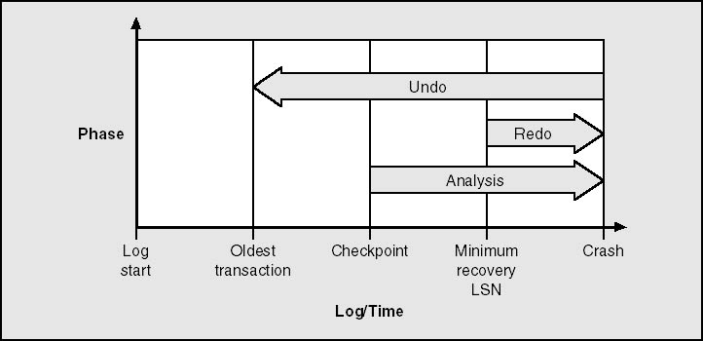
Data Recovery - Phases
Figure above: The three phases of the SQL Server recovery process

Slide 19
Data Recovery - Phases
Phase 1: Analysis
  The first phase is a forward pass starting at the last checkpoint record in the transaction log
  Determines and constructs a dirty page table (DPT) consisting of pages that might have been dirty at the time of the crash (or when SQL Server stopped)
  An active transaction table is built that consists of uncommitted transactions at the time of the crash
Phase 2: Redo
  This phase repeats history by returning the database to the state it was in at the time of the crash

Slide 20
Data Recovery - Phases
  The starting point for this forward pass is the minimum of all the LSNs in the DPT
  The DPT is used to avoid reading pages that don't need recovering and to avoid overwriting non-logged changes
Phase 3: Undo
  This phase moves backward from the end of the log, following the links between entries in the transaction log for each transaction
  Any uncommitted transaction at the time of the crash is undone, so that none of its changes are actually reflected in the database

Slide 21
Recovery: Behind the scenes
LSN in the page header maintains a version of changes whenever rows on the page are changed
This page LSN reflects the location in the transaction log of the last log entry that modified a row on this page
During Redo, the LSN of each log record is compared to the page LSN of the data page that the log entry modified
If the page LSN is less than the log LSN, the operation indicated in the log entry is redone
Recovery finds the last checkpoint record in the log (plus transactions that were still active at the time of the checkpoint)

Slide 22
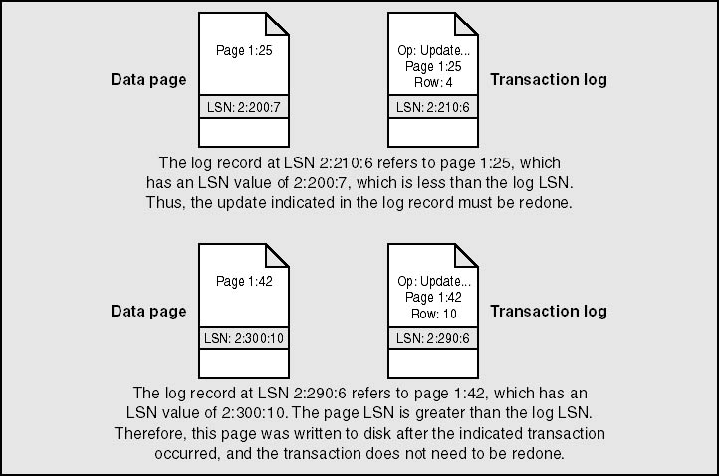
Recovery: Behind the scenes

Slide 23
End of Topic – Transaction Logs
?

Slide 24
End of Topic – Transaction Logs
Thank you
Next Topic
Architecture Components | Storage Concepts | Transaction Logs | Indexes I | Indexes II | Locking I | Locking II | Query Processor

